Slide 1


Moments
Design
Team 07
Yifan Xu
Wenxi Ran
Chen Sun
Chang Liu
Wentao Shi
Zhanyu Sha

Slide 2

01
Project Adjustments
02
Architecture
03
Algorithm design
05
Evaluation Design
04
Database Design
06
UI Design
07
Review Plan
Overview

Slide 3
PART 01
Project Adjustments

Slide 4
Changes to the original project
Target User
Website Aim

Slide 5
Target User
University
Department
Society
University
Department
Society
Website Visitor
Web Admini
-strator
Student
Student
After Adjustment
Original

Slide 6
Website Aim
Interactive
Information Sharing

Slide 7
PART 02
Architecture
Network Architecture
System Architecture
Use case
Component
Sequence diagram

Slide 8
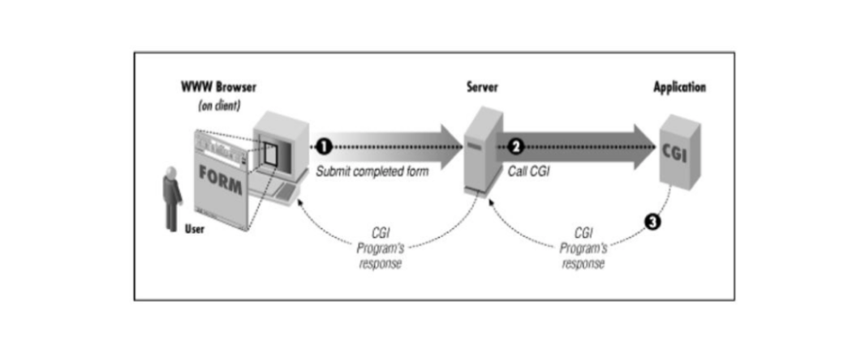
Network Architecture
Overview of web server: Tentent Cloud Server
Security of the network : RSA signature
Perl and CGI, PHP

Slide 9
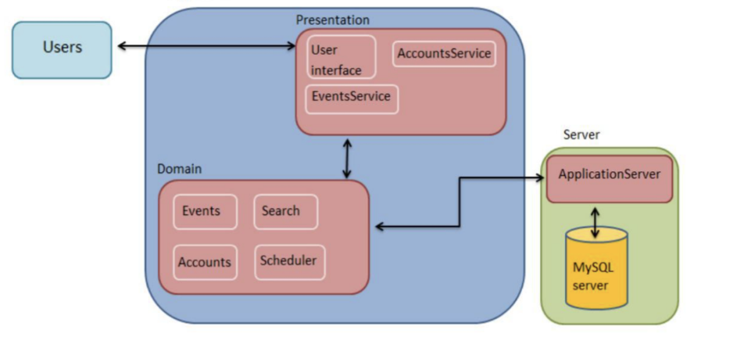
System Architecture
Model View Controller
Users, application, Server
Object-oriented

Slide 10
Component
HTTP WEBSITE
Entities:
visitors,societies,events,
web administrator
Mian entities:
Visitors, Societies, Events, Web administrator
Main functions:
Chartroom, Recommender System...
Funcions
Accounts manager, Chartroom, Recommender System...
Databse

Slide 11
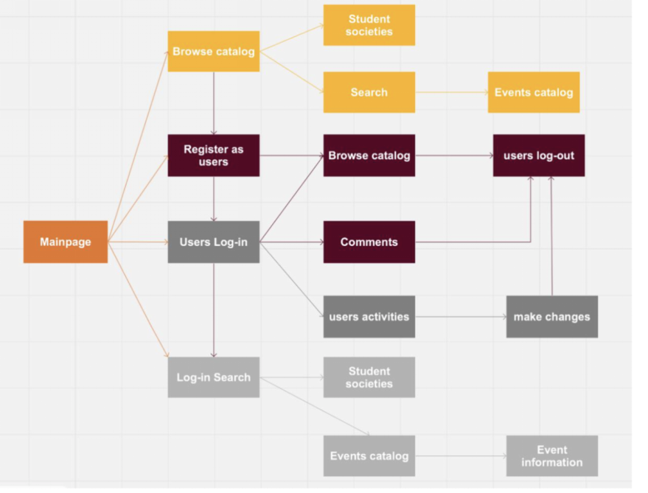
Structure and Navigation
Before Log in:
Event, Society
After Log in: Coment,chatroom

Slide 12
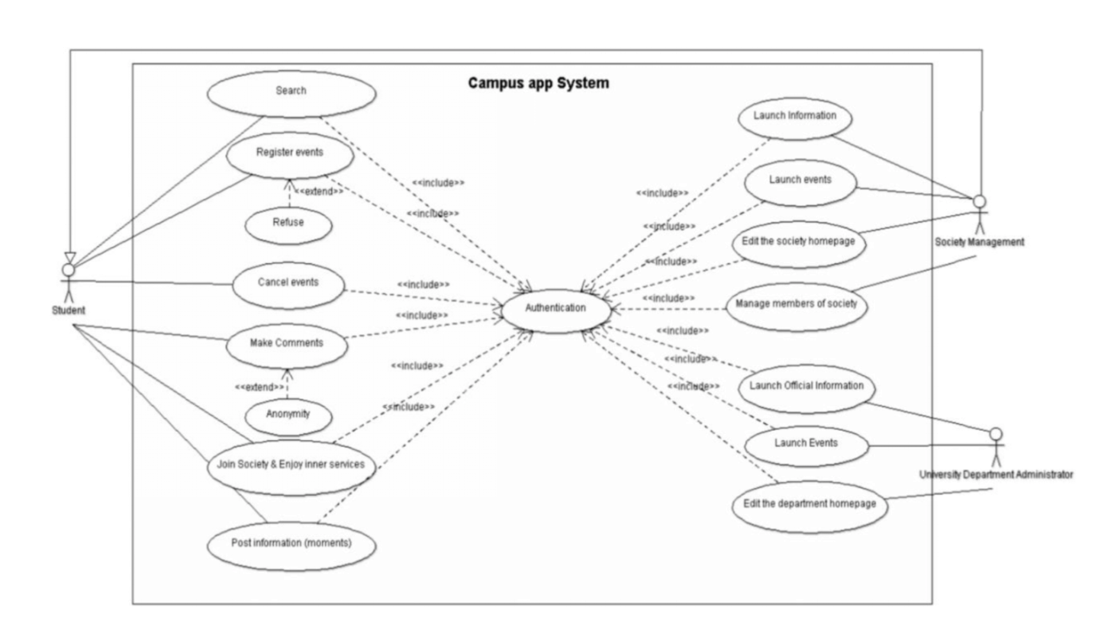
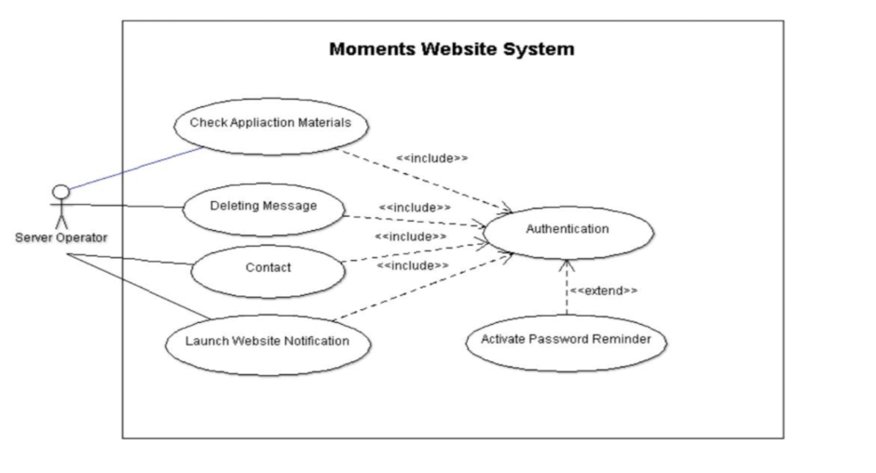
Use Case Diagram
Web administrator

Slide 13
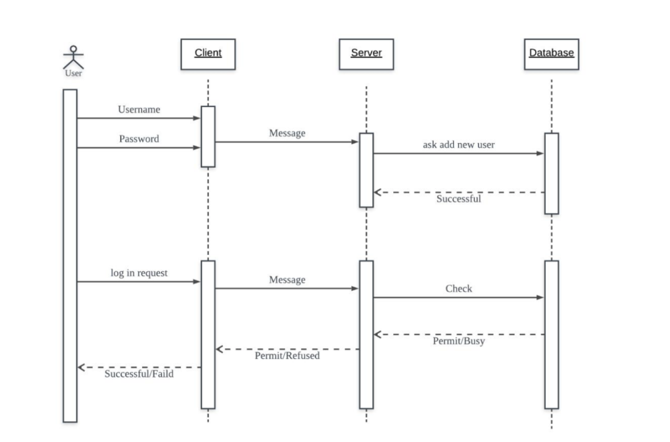
Register and login sequence diagram

Slide 14
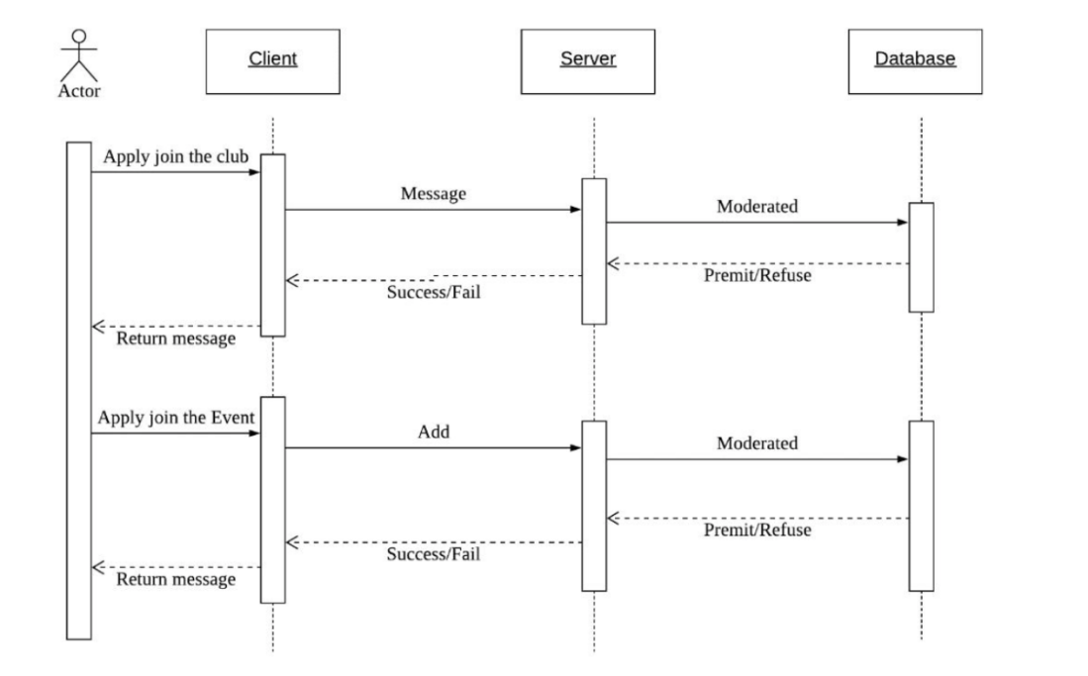
Join the clubs and events sequence Diagram

Slide 15
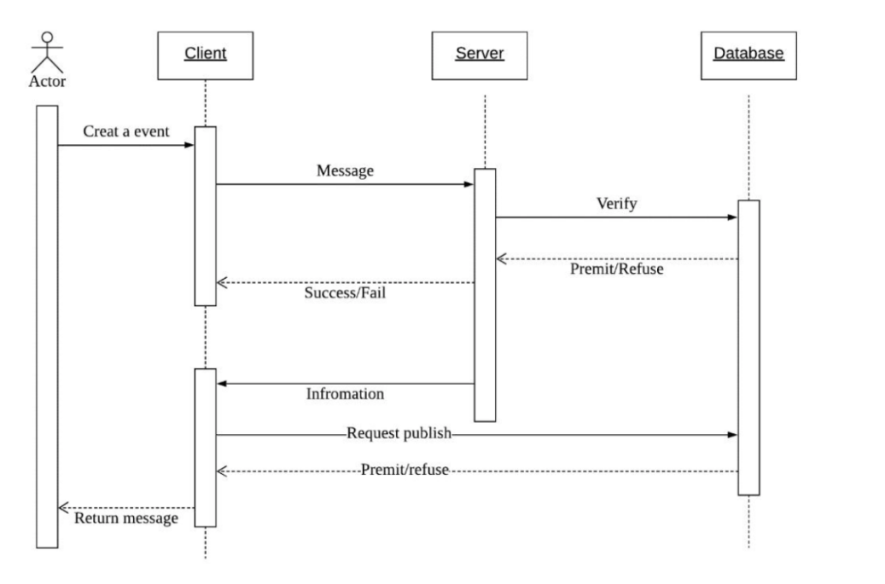
Event Sequence Diagram

Slide 16
PART 03
Algorithm design
General Functions

Slide 17
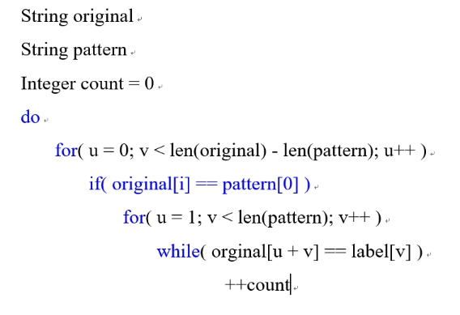
Search matching algorithm
Description
Match the string and the search content.

Slide 18
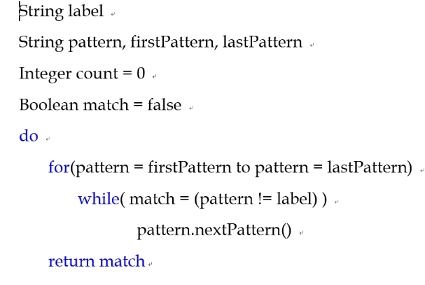
Label and event matching
Description
Give each club and event a label and match serch content with label.

Slide 19
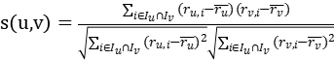
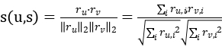
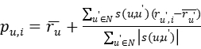
User-based collaborative filtering
Person correlation coefficient
Method steps：
Collect user information Nearest neighbour search (NNS)
The function of similarity:
Cosine-based Similarty
Adjusted Cosine Similarity

Slide 20
Trending association algorithm
for(i=1;i<=sum(association);i++) { for(j=1;j<=5;j++) { number[i]=exec(“SELECT number FROM search WHERE search_date=date-i”); } weight[i]= 5*number[1]+4*number[2]+3*number[3]+2*number[4]+number[5] insertItem(weight[i])
} for(int k=1;k<=10;k++) { top[k]=removeMax() } }

Slide 21
PART 04
Database Design

Slide 22
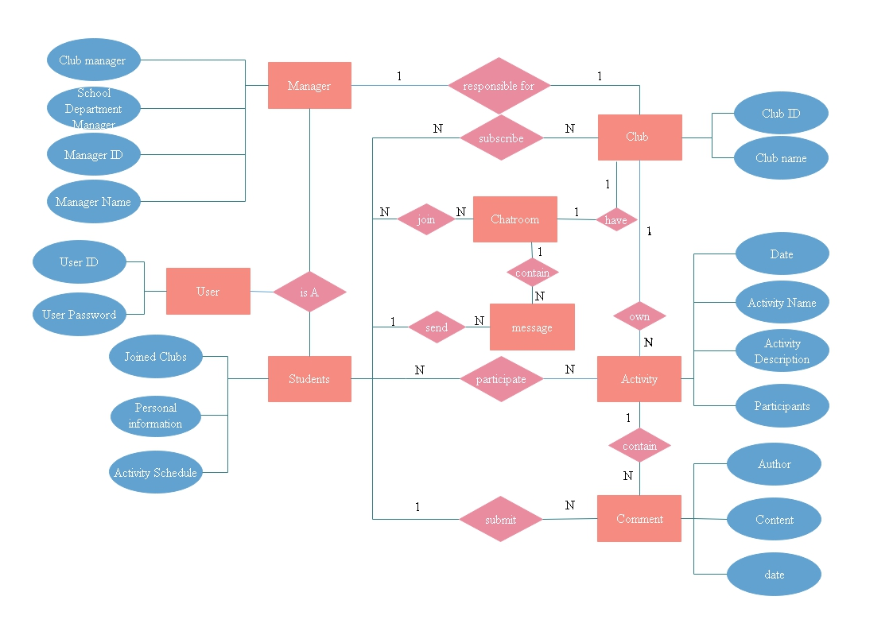
Entity-relationship diagram

Slide 23
logical table structure
User(ID,user_login,user_pass,user_email,user_registered,display_name,profile_name) Primary Key ID
Usermeta(umeta_id,user_id,meta_key,meta_value) Primary Key umeta_id Foreign Key user_id references user(ID)
Association(association_ID,association_name,memberNum,association_description,chatroom_ID,is_department) Primary Key association_ID Foreign Key chatroom_ID references user(ID)
Association_touser(touser_ID,association_ID,chatroom_ID,user_ID,user_level,user_sendLastTime) Primary Key touser_ID Foreign Key user_ID references user(ID)
Event(event_ID,event_name,event_date,event_description,association_ID,association_name,event_status) Primary Key event_ID Foreign Key association_ID references association(association_ID)
Eventmeta(eventmeta_ID,event_ID,meta_key,meta_value) Primary Key eventmeta_ID Foreign Key references event(event_ID)
Comment(comment_ID,comment_association_ID,comment_event_ID,comment_display_name,comment_author_IP, comment_date,comment_content,comment_agent,comment_user_ID,) Primary Key comment_ID Foreign Key comment_association_ID references association(association_ID) Foreign Key comment_event_ID reference event(event_ID) Foreign Key comment_user_ID reference user(ID)
Groupmsg(msg_ID,chatroom_ID,msg_senderID,msg_sendername,msg_senderIP,msg_date,msg_content,msg_agent) Primary Key msg_ID Foreign Key msg_senderID references user(ID)

Slide 24
File organization
usermeta: hash file
eventmeta: hash file
association_touser: hash file
other: sequential file

Slide 25
Security mechanisms
Allow one user to undertake all kinds of operations related to website
GRANT SELECT, INSERT, UPDATE, DELETE on website to user@localhost;
Can't modify database structure and other users' privilege
Can't view other databases that are not related to website
Check permissions of users who perform related operations and their input in the front end and the back end.
Add a function used to records information related to malicious attacker
return warning message if system detects that malicious input sent by a user for many times

Slide 26
PART 05
Evaluation Design
Furps model

Slide 27
Functional Testing
Standard:The length and upper/lower case/each character of password should be exactly the same as the one set at the registration.
Search an events/ clubs/university department/users separately for 30 times.
Standard:80% result is related.
Log in testing
Search function testing

Slide 28
Chatroom function testing
Sending 100 messages.
Standard:Average Time: 3s
Black box test: Repeatly login with with the same account for 10 times and participate in an activity each time. Evaluate the system’s recommendation when logged in next time
Standard:Accuracy rate: 80%
White box test: k-nn AI algorithm
Standard:Accuracy rate:85%
AI recommender system testing

Slide 29
Performance Testing
Run the web in different systems to see whether 1. User’s requests are swiftly responded.
2. The website is stable

Slide 30
Usability Testing
Ease use.
Assign several tasks to 100 users and record the average time for them to complete the tasks.
Searching bar.
Access club page, individual page, individual activity schedule bar.
Look for interested club without searching.
Sign up for activity

Slide 31
Recoverability Testing
Design checkpoint (Internet broken, concurrent connection with server, multiple user registration, receive unexpected data)

Slide 32
Security Testing
Security tool (SQL injection, PHP File Include).
Expect sensitive input which might be code from malicious users to cause system to malfunction or reveal the content of database.

Slide 33
Database Evaluation
Check the semantic meaning of the attributes.
Reduce the redundant information in tuple.
Reduce the null value in tuple.

Slide 34
PART 06
UI Design

Slide 35
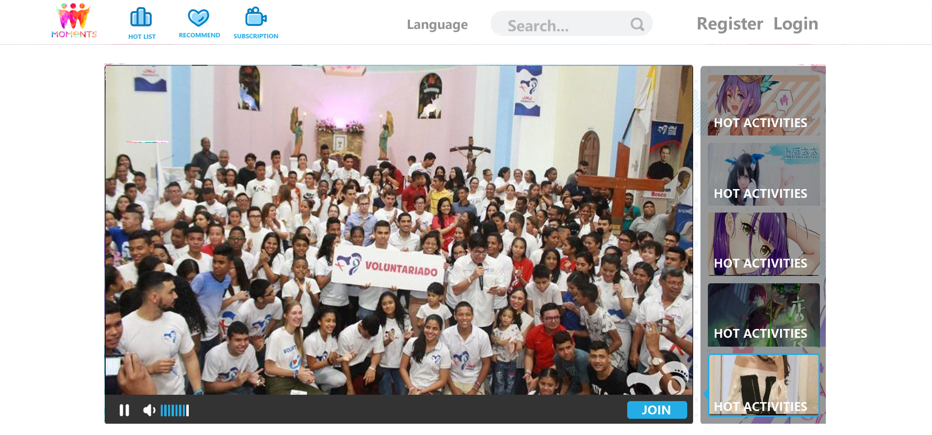
Homepage 1

Slide 36
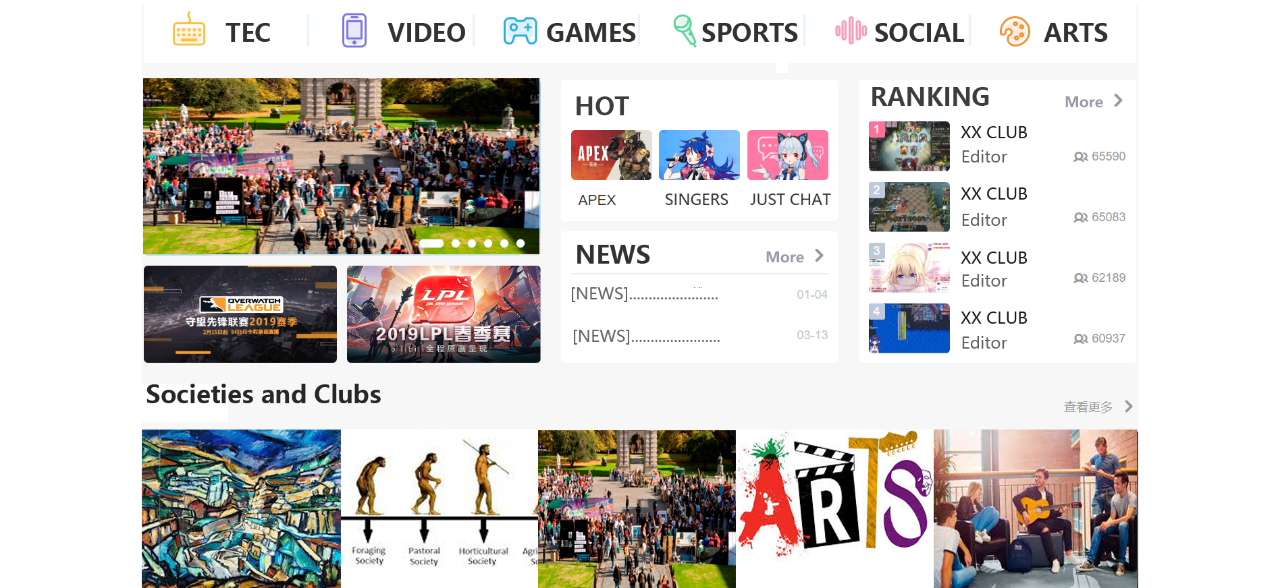
More
Homepage 2

Slide 37
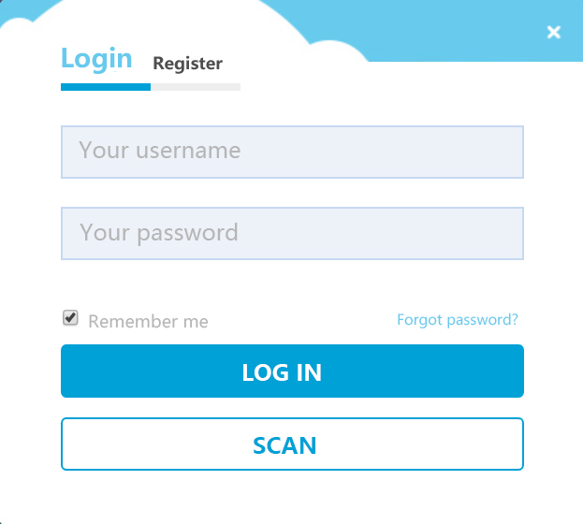
Login

Slide 38
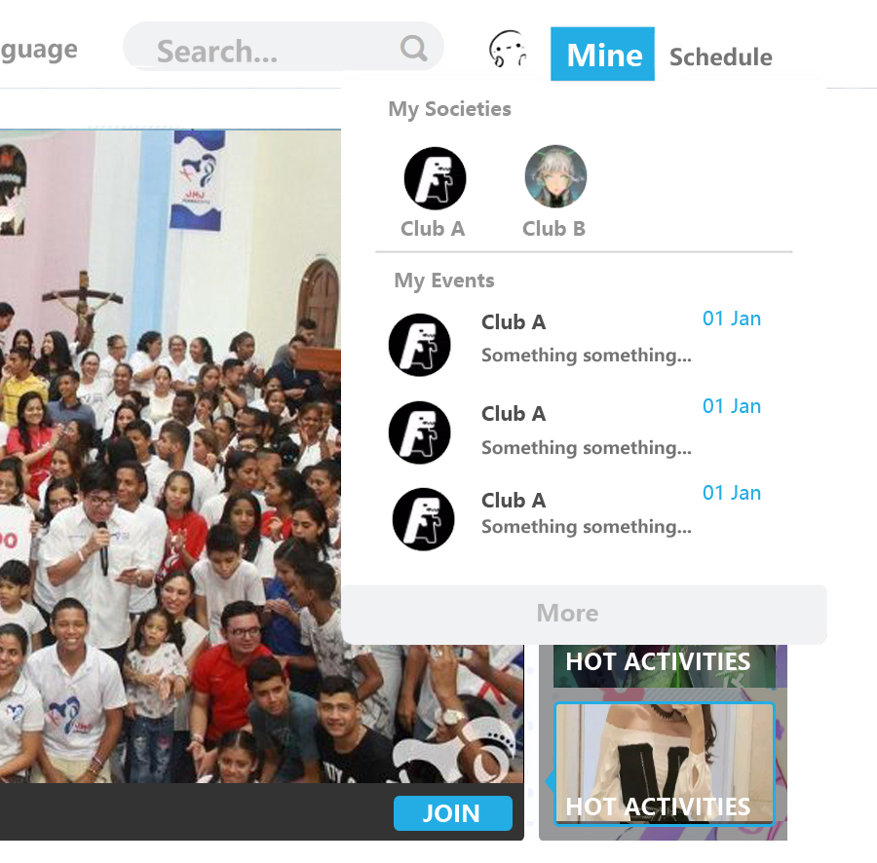
Personal navigation bar

Slide 39
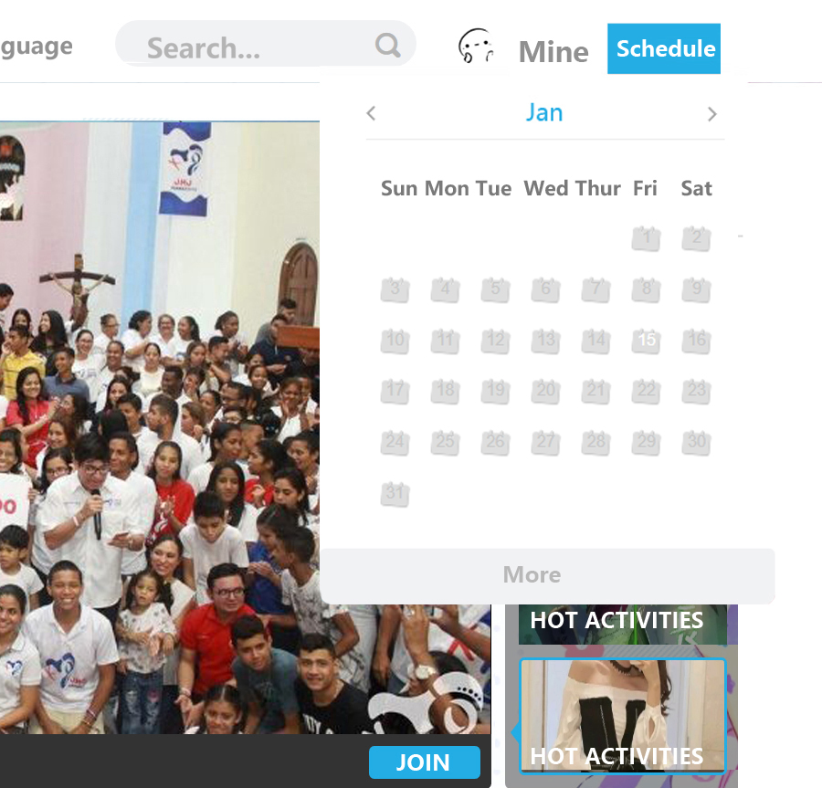
Personal navigation bar

Slide 40
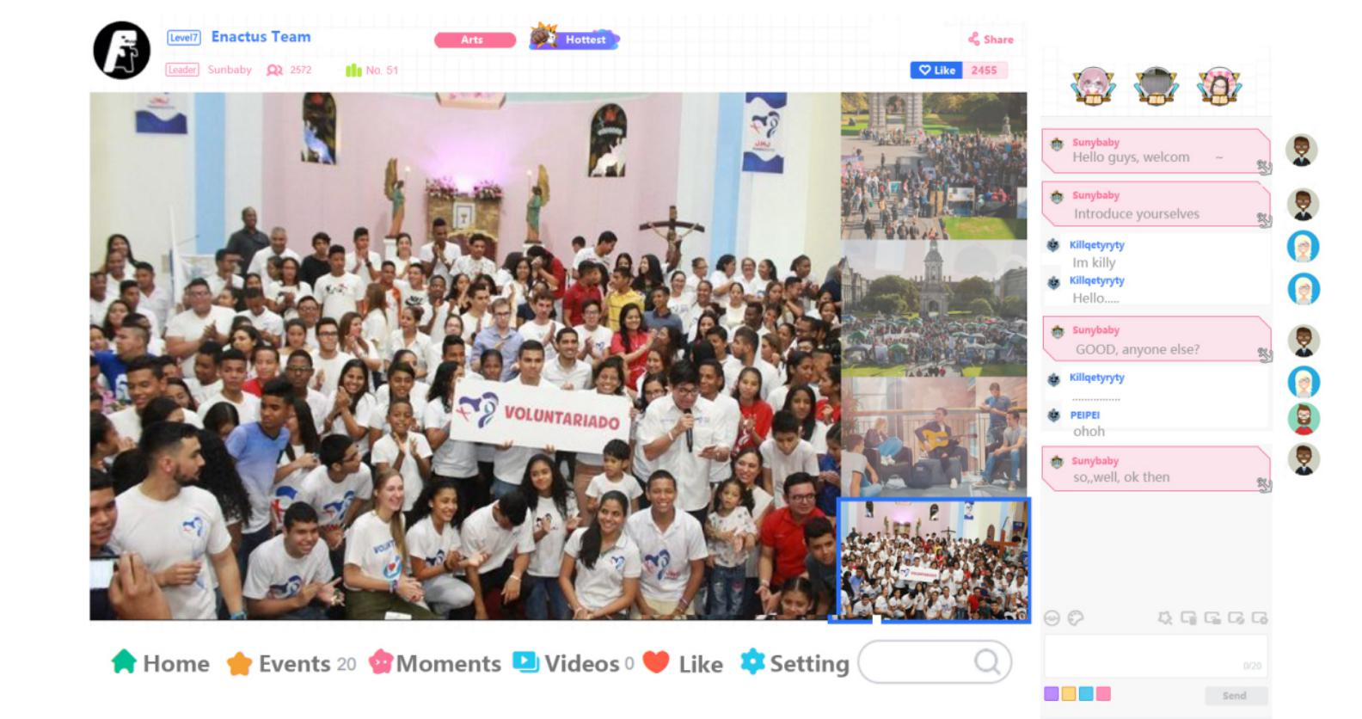
Societies and clubs homepage

Slide 41
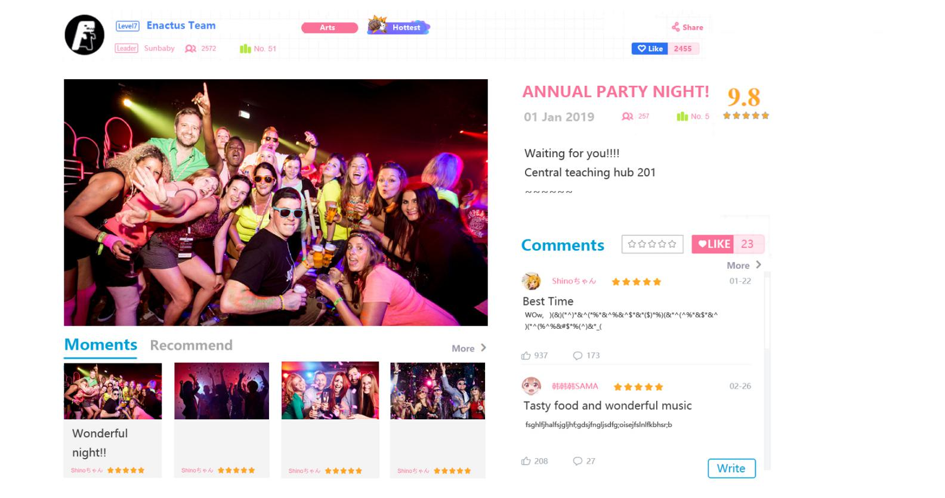
Events

Slide 42
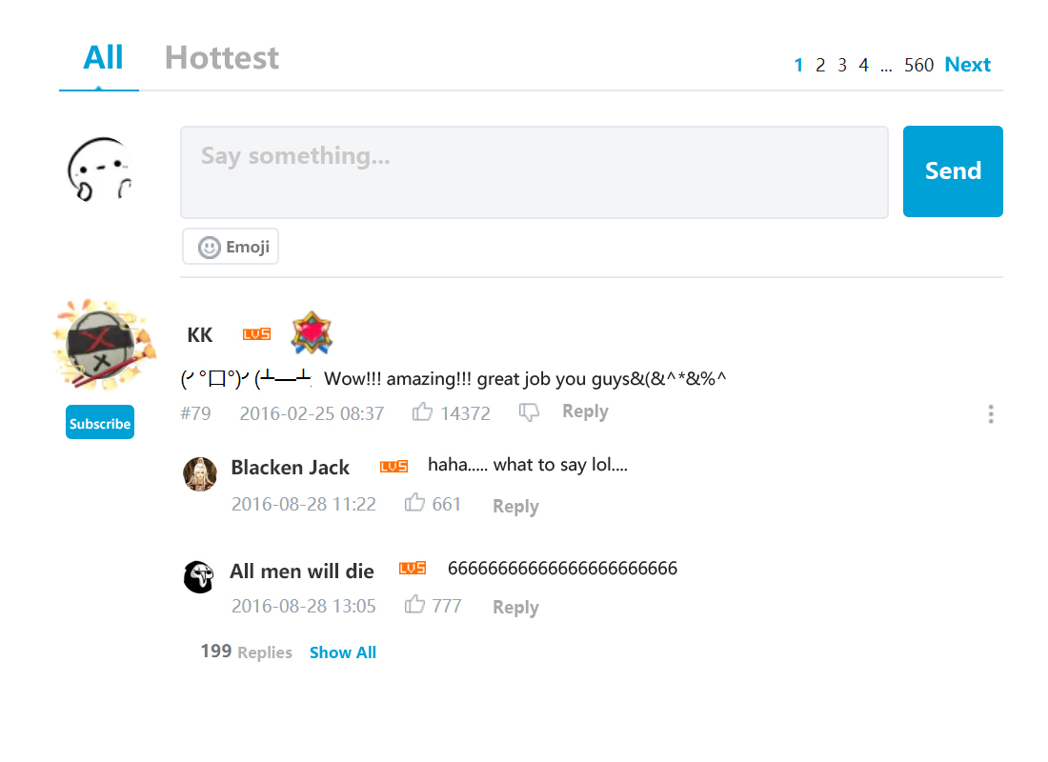
Comments

Slide 43
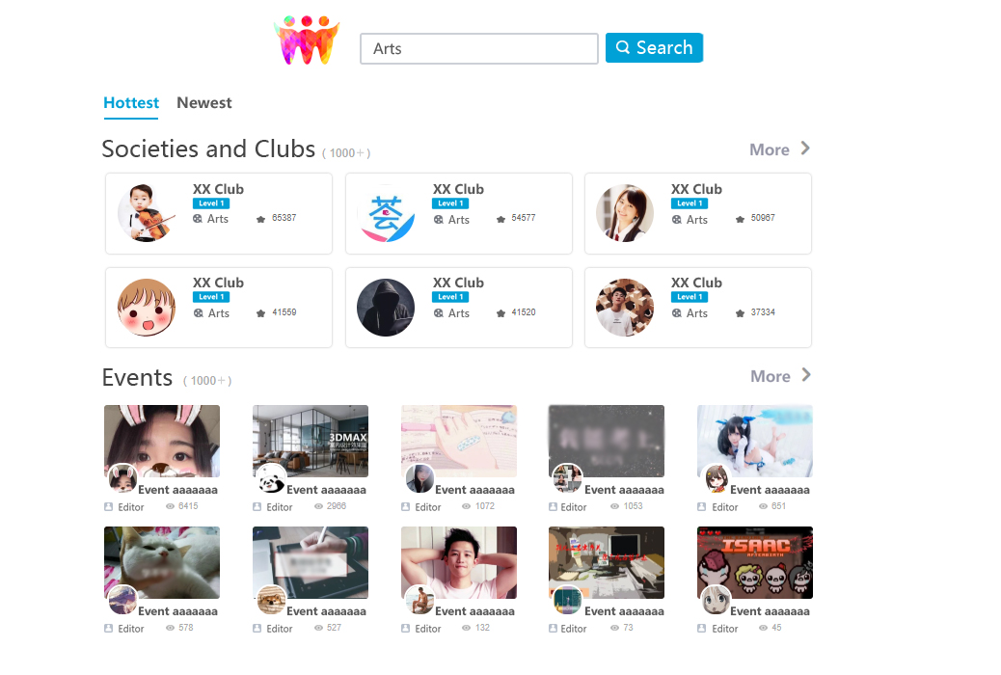
Search result page

Slide 44
Business Rules
Membership system
Advertisement
Original works

Slide 45
PART 07
Review Plan

Slide 46
Completed Work
1. Requirement analysis (Finish Date: 2/15/2019)
a. Project background research
b. Website functions analysis
c. Produce corresponding requirement documentation
2. Project design (Finish Date: 3/14/2019)
a. Design research
b. Interface design
c. Database design
d. Draw related design diagrams and chart
e. Produce corresponding design documentation

Slide 47
Completed Work
3. Web pages design & implementation
a. Design the major web pages settle the contents and layout
b. Implementation the webpage design with HTML, CSS, JavaScript
4. Website database construction

Slide 48
Future Plan
Website user interfaces implementation
Structure database
Desirable functions
Testing

Slide 49

THANKS
Best friends,
Best

